Slide 1

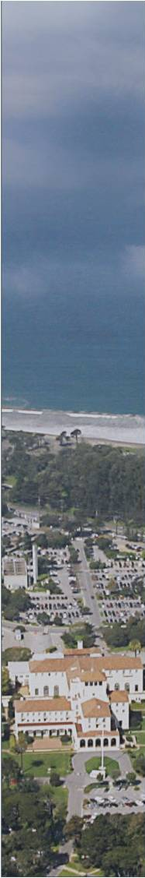


Student Intern
Orientation Brief

Slide 2

General Emergency Response
Review emergency procedure with your Mentor
Determine Muster (meeting) place, with your Mentor
Be aware of “Shelter in Place” as a Response
When you are secure:
Text Alison Kerr (cell phone) 831-521-9335
“I am Safe - I am at _______ Name __________”
Recommend add “NPS” or “STEM” to name on phone entry, for quick recall
Call (9) 911 emergency services
in case of serious or life-threatening injuries!
2
Notes:
Signage is also important. For example, the nanomems sign you see here is located outside of Watkins Hall. The colors symbolize categories and numbers 0 through 4 symbolize severity, with 0 being the least sever. Therefore, this sign shows that Acid, for those who don’t already know, is reactive with other chemicals and is an extreme danger to health.

Slide 3
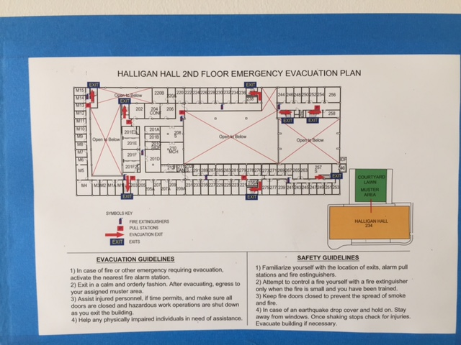
Evacuation Routes
Know your Nearest Exit

Slide 4
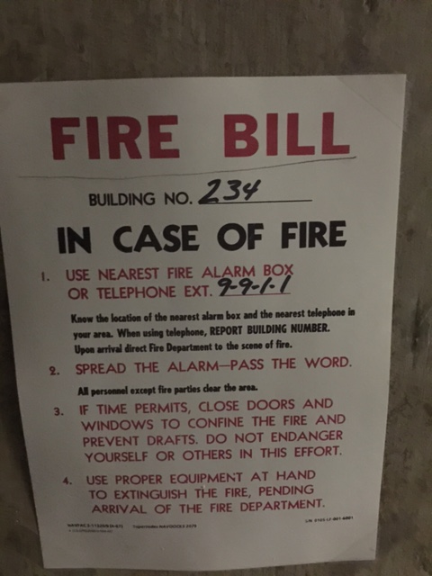
Fire Response
What Building Are you in?

Slide 5
Navy ORM
Risk Management
Take time to assess the situation
Identify hazards– brainstorm
  What’s the worst thing that can happen?
  Visiting the cliffs? Seashore?
Assess the hazards – probability and severity
Make risk Decisions
  Most severe and probable hazards (risks) first!
  What can reduce the severity or probability of the hazard?
  What would it take to make that risk reduction happen?
  Cost benefit analysis – if its appropriate, decide to do the mitigation
Implement mitigations
Supervise!
Pass along lessons learned to your workers, supervisors, friends, etc. Local Scary Event.

Slide 6
Navy ORM
Risk Management
Takeaway: Four PRINCIPLES of ORM
Never take an unnecessary risk!
  Running a light to get to the next red light.
Accept risk when benefits outweigh the costs
Anticipate and manage risk by planning – drinking at a party?
  Manage your risk deliberately – don’t be surprised.
Make risk decisions at the right level
  Life and work is not zero risk, but it can be managed.

Slide 7
Monterey HAZARDS and Mitigations
Sunburn - You can get sunburned in fog - sunscreen, sunglasses
Hypothermia - Dress in layers and carry a warm jacket - prepare
Hypothermia - Water temperature is cold - prepare
Drowning – Riptides can be deadly – recognize and avoid
Drowning, Trauma - Rogue waves have caused deaths – be aware, never turn your back on the ocean
Sting – Yellow jackets, honeybees, stinging nettlefish
Bite – Geese, coyote, seals – be aware, avoid
Disease – Raccoons - avoid
Rash - Poison Oak is common in forests and hiking/biking area - Recognize, avoid, cleanse

Slide 8
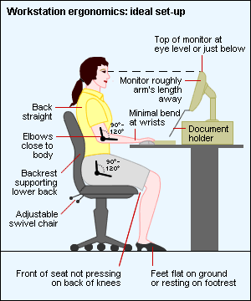
ERGONOMICS
Some (bad) habits over time become painful.
Be aware (and avoid) heavy lifting, repetition, vibration, joint stress.
Can it be done smarter?
8
Notes:
Be PROACTIVE - Don’t let fatigue and discomfort reach your pain level…ask us to help.

Slide 9
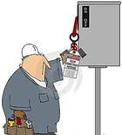
Equipment and site HAZARDS
Electrical Power, Potential Energy
  Lockout procedures must be in place for all potential energy equipment and processes.
  Restoration from Lockout is a controlled operation.
Fall Protection
  Roofs
9

Slide 10

CONFINED SPACES
Enclosures with limited means of entry/exit
that are not designed for continuous occupancy.
Examples: Tunnels, Storage tanks, pits, sewers, underground utility vaults, and manholes.
Report unlabeled spaces.
3. ENTRY IS PROHIBITED
10

Slide 11
Hazards Materials
Do not bring Hazardous Materials to NPS.
  Anything you wouldn’t want to eat, breath, or put in your house
  Don’t take any out
  Dispose of HAZMAT in the lab by direction of your mentor
Don’t put anything in the trash you wouldn’t want in your drinking water
  Batteries
  Toner cartridges
  E-waste
  HAZMAT, etc, etc.
11

Slide 12

HAZARDOUS MATERIALS COMMUNICATION
Standard = 29 CFR 1910.1200.
Right to Know Hazards in the workplace.
12
Notes:
Our next topic is HAZARD Communication. So what is it? Hazard Communication is your right to know what chemical hazards are in the workplace. However, not all of you will be working around hazards and chemicals. So we’ll briefly touch on NPS HAZMAT requirements for your awareness.

Slide 13
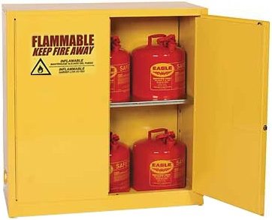




HAZARD COMMUNICATION
Training Requirements:
  Chemical or Equipment Specific
  Safety Data Sheets review
  HazMat and Safety Program Overview
  Proper Labeling & Storage
  Access Controls, Log Books
  PPE – Personal Protective Equipment
  SOP- Standard Operational Procedures
  Watch for Radiation, Laser, RF, and Chemical Caution Signs
13
Notes:
We have many chemicals here at NPS that are not typically found at other military installations due to our unique research and educational setting. Therefore, it’s important that anyone working with chemicals is trained on specific uses and the HAZMAT Installation Program. This training should be provided by your departmental hazmat representative or lab supervisor, and should include proper use, storage, and labeling for chemicals, as well as a review of the Material Safety Data Sheets.
Every chemical container at NPS must be labeled with the chemical name, manufacturer, point of contact or owner, and expiration date. It must also have an MSDS readily accessible. Please report to the lab supervisor any container not labeled or stored correctly.

Slide 14
Environmental Impacts
Plan to use the least toxic materials
Use only what you need in materials and energy
Water conservation is important in Monterey
Be aware of endangered or sensitive plants and animals during outside activities, especially in undeveloped areas.

Slide 15
MISHAP REPORTING
All Mishaps shall be reported. (What’s a mishap?)
All Interns have the responsibility to notify their supervisor when a mishap or injury has occurred in the workplace.
Reporting mishaps helps raise awareness, get corrections made to the hazard, and identify trends or bigger problems.
Slips, trips, and falls
  Distracted Walking
Lab Incidents
15
Notes:
PPE (List)
Engineering controls come first & PPE is then utilized as a last line of defense.
As a student, you may have access to posted NOISE HAZARD areas. You’re Lab Manager / Professor will review the use of required PPE and SOP’s with you.
In some labs, students are utilizing Dust Masks (a.k.a., filtering face-pieces) as part of OSHA’s ‘Employee Voluntary Use of Respirators’ program. There is a requirement to be briefed by your lab manager on an annual basis.

Slide 16
Finally!
The best and worst Monterey Beaches
Monterey Bay Beaches
  Recent Scary incident
16
Notes:
PPE (List)
Engineering controls come first & PPE is then utilized as a last line of defense.
As a student, you may have access to posted NOISE HAZARD areas. You’re Lab Manager / Professor will review the use of required PPE and SOP’s with you.
In some labs, students are utilizing Dust Masks (a.k.a., filtering face-pieces) as part of OSHA’s ‘Employee Voluntary Use of Respirators’ program. There is a requirement to be briefed by your lab manager on an annual basis.

Slide 17
CONTACT INFORMATION
Questions?
Have a Great Summer!
Work and Play - Stay Safe!
NPS OSHE Directorate (831) 656-1072
http://my.nps.edu/web/safety/
safety@nps.edu
GOOGLE: NPS Safety (+[hazard] like posters, lasers, chemicals, batteries, sight, hearing, lead, radiation…)
17

Slide 18
Local Scary Event
I went for a bike ride this morning and almost didn't come home. I cruised out over Toro, down the Grade and headed up Robinson Canyon. Part way up the climb, a gray Honda civic passed me. He was close, but the road is narrow and I didn't think much about it. Until, a couple of minutes later, when I saw him pulled off to the side of the road and he was out of his car. This immediately put me on edge, as most of the time, this means the driver is angry and wants to "have words." It was a fairly steep part of the road and as I got closer, he yelled out that he needed directions and wanted to know where the road went. I stopped as it was impossible to talk (middle of a hard effort) and too steep to keep rolling and talk. I was annoyed at having to stop, but didn't want to be rude either. I explained that it is an out and back road, with a housing complex at the top, but it is a gated community with security guards.

Slide 19
Local Scary Event
He then asked if he could use my phone and I said no. He then asked if we could "see the guards, just up the incline?" I glanced in the direction he was pointing and told him I didn't know what he was looking at, and I started to roll away. He wanted me to come take a closer look and I told him I needed to keep going. I started to roll downhill in order to clip in, with the intention of looping around and continuing up the climb. (It is hard for me to clip in on a steep hill as it loads up my hip that I had surgery on.) As a started to flip around and continue up the climb, a voice in my head told me to listen to my gut and get out of there. I argued with it, trying to tell myself how much I would enjoy the last (steepest) bit of the climb. But something was wrong. I listened to my gut and started to descend. As I descended, I knew I had done the right thing. A couple of minutes into the descent, I heard a car behind me.

Slide 20
Local Scary Event
I was already over to the right, but glanced over my shoulder and it was the Honda. He came up next to me and started drifting into me, forcing me to stop, as I had no pavement left to continue. He had the passenger window down and was telling me that he had another favor to ask me. I was angry, scared and trying to figure out what I could do to defend myself. I had no where to go. I looked into the car and asked him what he needed. He said, "oh, I need to move something in my trunk, can you just help me out with that?“ I honestly almost laughed out loud in disgust, fear and anger. I wanted to ask if I looked stupid enough to just load myself in his trunk, and make it an easier crime for him. But I didn't. I told him my husband had just called and was upset that I was making him and the group wait for me at the base of the climb and I needed to go. And he drove off. I was left standing on the side of the road, shaking in rage and fear.

Slide 21
Local Scary Event
I knew that it wasn't safe to continue to descend, as now he was in front of me and could set up a road block and try to grab me or hit me. I was about to call the police, when I saw another car heading down my direction. I flagged it over and it was a lovely couple who agreed to escort me down the climb. I went first and they followed. A couple of corners later, what did we come upon? Same Honda, parked in the middle of the tiny road, with ALL OF THE DOORS OPEN. I couldn't believe it. We made it down to the bottom and I stopped to thank my angels. The helpful couple were horrified. That was when I realized, what had just happened. I was being hunted. AND THERE WAS LITTLE I COULD DO ABOUT IT. I am not sharing this to make people scared. I share to remind people that bad things could happen in our small, friendly, and beautiful corner of this world. Nurture and TRUST your street sence. When it says something isn't right, listen.

Slide 22
Local Scary Event
Have a plan. (Mine was to throw my full water bottle and I had already reached down and acted like I was tightening my shoe, and thought I could yank it off and use it as a weapon... not ideal but I was improvising fast... and hey, those cleats would leave a mark, and that comfort thought allowed me to keep “fast” thinking about other ways to stay clear of this trouble!) And don't show fear. I was kind, but firm. And as I realized this was a dangerous situation, I sought help from others. Never be embarrassed to ask for help. I hate to bother people and I was worried that the couple in the car who escorted me down would think I was a complete loon. Who cares about that! It got me home. I was almost stuffed in the trunk of a car. I was hunted by an experienced and crafty criminal. It isn't a nice feeling. Make sure you listen to your gut. I have reported this information to the police.
Return to ORM

Slide 23
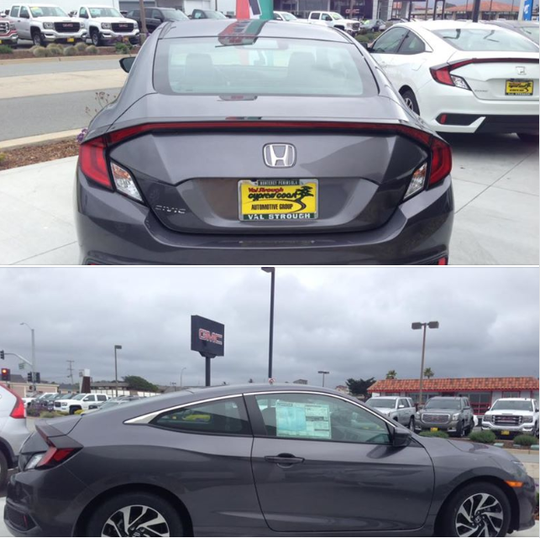
Local Scary Event
Description of person (17May2018)
Hair: Quite dark/black and cut fairly short and had a gelled look
Top: Don't know
Bottom: Don't know,
Shoes: Don't know
Age: Mid 20s to mid 30s
Build: 5'8 to 5'11. Medium build
Race: Hispanic
Sex: Male
Other details: Clean shaven
Vehicle
Make: 2017-18 Honda Civic Hatchback
Color: Gray,
Plates: Sam Linder Dealership paper plates

Slide 24

Return

Slide 25
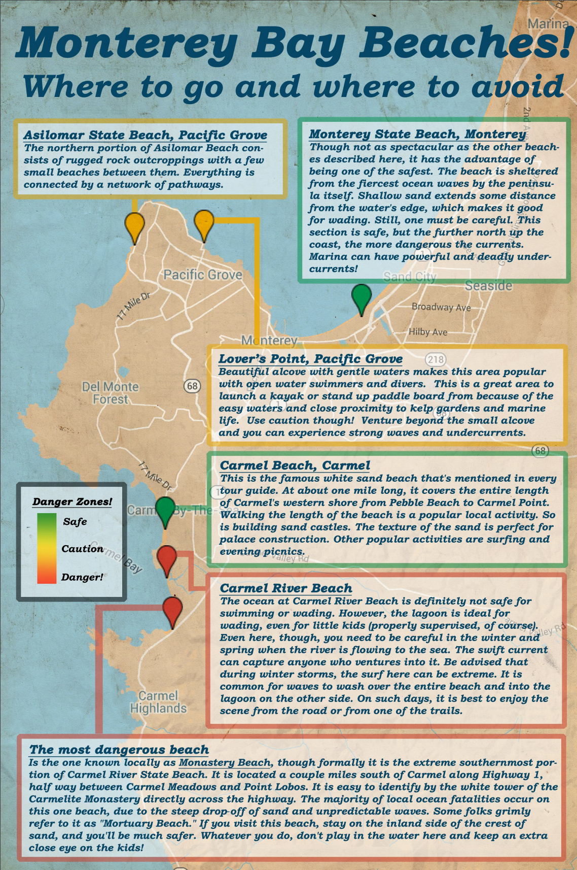
Return

