Slide 1

DIRECTORATE FOR SAFETY,
HEALTH, AND ENVIRONMENTAL

Slide 2

Overview
Our Mission
Installation and Local Safety Hazards
Safety Information
Employer and Employee Rights & Responsibilities
Reporting Mishaps
Hazard Reporting
Training
Personal Protective Equipment (PPE)
Motorcycle Training / Base Regs
Hazardous Energy Control (LOTO)
Job Hazard Analysis (JHA)
Fall Protection
Hazmat (Right-To-Know)
Emergency Management
Contact Information
Questions?

Slide 3

Our Mission
Directorate for Safety, Health, and Environmental support of NPS mission: Academic and Research readiness. It is the mission of NPS Safety Directorate to save lives and provide academic and research readiness, through risk identification and mitigation.
How we achieve the mission:
Focusing on Leading indicators
Engaged Leadership (Councils, walkthroughs)
Hazard Identification
Inspections
Contract Reviews
Proposal Reviews
Process Improvement goals (measures)
Reports of unsafe and unhealthful/Near miss
Training
Readiness Through Safety

Slide 4



Installation and Local Safety Hazards
Historical stairs & steps can be worn and slippery. Caution should be taken when using them and handrails should always be used. Most mishaps occur due to Slips, Trips, & Falls.
Uneven sidewalks and paths located in various areas within the installation. Always pay close attention to your surroundings & look for items that may cause a trip hazard & be especially mindful of this while looking at your cell phone.
Be watchful and alert when driving on/off the installation. Do not text and drive and avoid all types of distractive driving.
Be aware of Diving and Beachfront Dangers, and when Cycling be alert of all your surroundings.

Slide 5

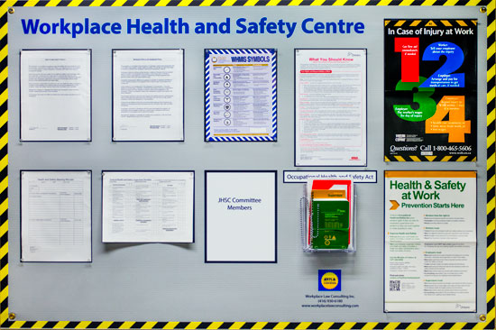
Safety Information
Safety Board Information

Slide 6
Rights and Responsibilities for Employers
Employer Responsibilities
Under the Occupational Safety and Health Act, employers have the following key responsibilities:
Provide a workplace free from serious recognized hazards.
Comply with all relevant OSHA standards, rules, and regulations.
Examine workplace conditions to ensure they conform to applicable standards.
Make sure employees have and use safe tools and equipment.
Establish or operating procedures and communicate them to employees.
Provide safety training in a language and vocabulary workers can understand.
Post OSHA citations, injury and illness summary data, and the OSHA "Job
Safety and Health: It's the Law" poster.
Keep records of work-related injuries and illnesses.
Report to OSHA any fatal accident or one that results in hospitalization of
three or more employees within 8 hours.
Provide medical examinations when required by OSHA standards.
Not discriminate against workers who exercise their rights under the Act.

Slide 7
Rights and Responsibilities for Employers
Employer Rights
Employers also have certain rights under OSHA:
Request an on-site consultation from OSHA.
Request and receive proper identification of OSHA compliance officers.
Be advised by compliance officers of the reason for an inspection.
Have an opening and closing conference with the compliance officer.
Accompany compliance officers on inspections.
Contest citations and request an informal conference with OSHA.
Apply for variances from standards when unable to comply but can
demonstrate alternative worker protections.
Be assured of the confidentiality of trade secrets.
Submit a written request to NIOSH for information on potentially toxic
substances in the workplace.
Request an extension of time for abatement of citations.
NOTE: This information can be found on Safety Information Boards.

Slide 8
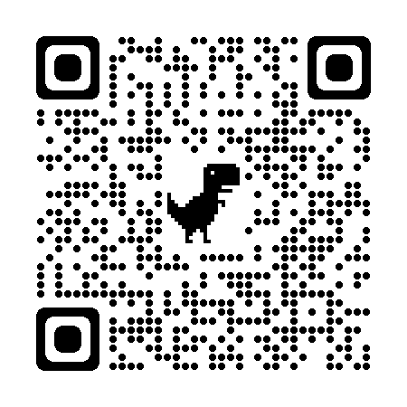
Reporting Mishaps
What is a mishap? Any work-related injury should be reported.
How to Report:
Online "Report a Mishap" Form - We have created an Online Form accessible from our safety site that all NPS personnel can utilize.

Slide 9
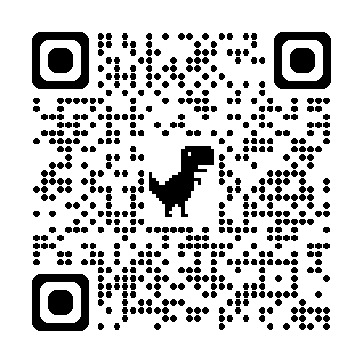
Hazard Reporting
It is critically important that NPS Personnel report all hazards to the safety office. We want to investigate and mediate any hazard discovered to prevent mishaps!
There are multiple ways to report:
Online form "Report a Hazard“ that NPS personnel can utilize.
Unsafe/Unhealthful Reporting Forms are available on Departmental Safety Bulletin boards.
Completed forms may be dropped off at our offices, and/or
emailed to Safety@nps.edu.

Slide 10


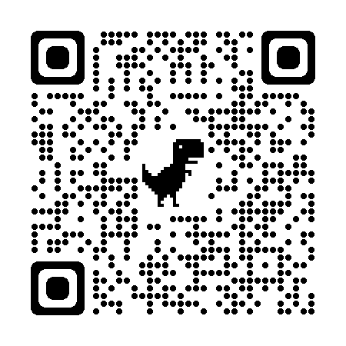
Training
Training:
Mandatory ORM Training (NEL)
RF Training (As Needed)
Ergonomics Training (Waypoints)
Hazardous Materials (Navy Safety Center)
Fall Protection (As Needed)
Recreational Off Duty Training (Safety Website)
LOTO / Hazardous Energy (As Needed)
Traffic and Motorcycle Safety (Safety Website)

Slide 11

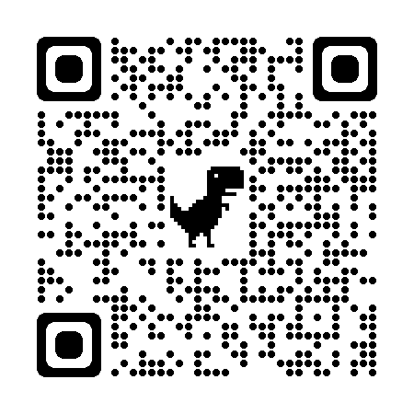
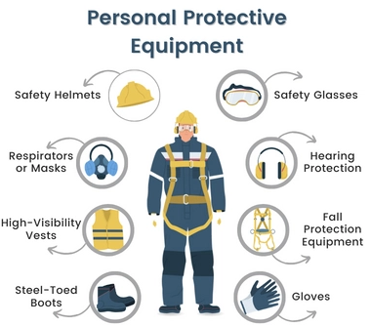
Personal Protective Equipment - PPE
Know your PPE:
Types of PPE
Risk Assessment Selection
Proper Usage and Fit
Maintenance and Replacement
Regulatory Compliance and Standards

Slide 12

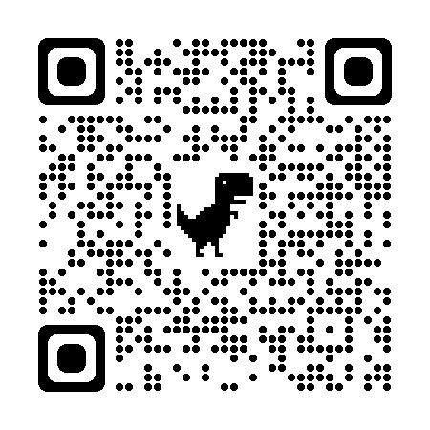
Guidance / Requirements
Motorcycle Safety
  Requirements to get on base
  License
  BRC Training Cert
  PPE
  Registration
  Insurance
Motorcycle Training Information

Slide 13

DBIDS
Motorcycle Safety
Beginning May 1, 2025
MOTORCYCLE DBIDS CARD REQUIREMENT
All DoD-affiliated motorcycle riders (Active-Duty Service Members and DoD Civilians) assigned to the NSA Monterey installation must present a motorcycle-specific DBIDS card at the installation Entry Control Point (ECP).
To obtain the DBIDS card, riders must go to the NSA Monterey Visitor Control Cetner and show registration, insurance, a valid motorcycle-endorsed driver’s license, CAC, and for Active Duty Service Members, a Motorcycle Safety Training Certificate.
DBIDS Card Expiration:
For military riders, the expiration will align with the CAC or Motorcycle Safety Training Certificate.
For others, the expiration will match either the CAC or motorcycle-endorsed driver’s license, whichever expires first.

Slide 14

Motorcycle Requirements PPE
Mirrors mounted on each side
Eye protection (not glasses): ANSI-approved safety glasses accepted
Helmet must meet DOT or Snell standards. with 3/4 to 1 inch of foam padding
Reflective Vest for
NBSD & NBC at all times
All other Bases require reflective material at night
NOTE: CANNOT BE COVERED BY BACKPACKS
Headlights on at all times
Long-sleeved shirt or jacket
Full-fingered gloves, leather or equivalent
Sturdy footwear -- NO tennis shoes -- Must be
over the ankle and securely fastened
Long-legged trousers
This meets all OPNAVINST 5100.12H requirements

Slide 15
Hazardous Energy Controls - LOTO
🔒 Energy Isolation: Lockout-Tagout ensures that all energy sources (electrical, mechanical, hydraulic, etc.) are properly isolated before maintenance or servicing begins.
🏷️ Use of Lock and Tag Devices: Authorized personnel must apply lockout devices (locks) and tagout devices (tags) to prevent accidental startup or energy release.
👷 Authorized vs. Affected Employees: Only trained and authorized employees are allowed to perform LOTO procedures, while affected employees should be informed about the controls in place.
📋 Written Procedures: Each type of machine or equipment should have a specific, documented LOTO procedure detailing how to shut down, isolate, lock, tag, and verify.
✅ Verification Before Work: After locking and tagging out the equipment, the employee must verify that all stored energy has been released and that the equipment cannot operate

Slide 16
Job Hazard Analysis
A Job Hazard Analysis is a systematic process that:
Laboratory procedures and research activities into basic steps (SOP).
Identifies potential chemical, biological, physical, & ergonomic hazards.
Establishes controls to eliminate or minimize exposure risks.
Serves as a critical training tool for laboratory personnel and students.
Prioritizes high-risk procedures involving hazmat or equipment.
Helps prevent accidents, exposures, and injuries before they occur.

Slide 17

Fall Protection Program
Fall protection required for working at unprotected heights in Excess of 4 ft. (any height above impalement hazards and dangerous equipment).
Roof Top access to all buildings is restricted only to those permitted.
When using stairs or ladders, always use three points of contact.
For more information concerning contact NPS Safety.

Slide 18

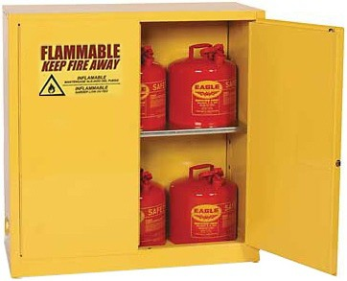
HAZMAT
SDS – Review Before Use!
Proper Storage Locker (Type of Material)
Proper Disposal (Not in the Trash)
Standard = 29 CFR 1910.1200.

Slide 19
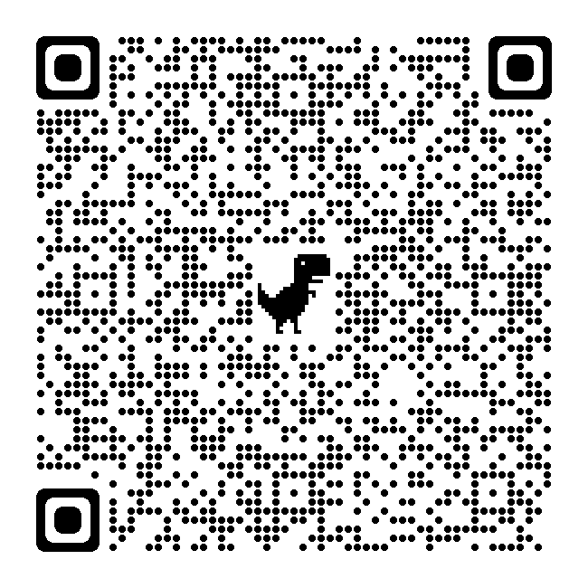
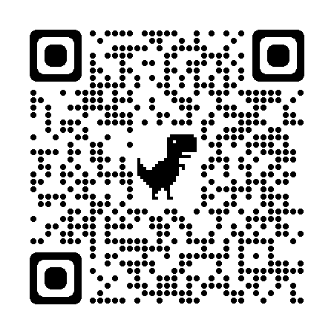
Emergency Management
• Call 911 to report emergencies
• Giant Voice - Method for mass notifications aboard NSAM the Giant Voice (GV) outdoor/indoor speaker system.
• AdHoc - Notification system, requires registration of your contact devices in order to receive a desktop/telephone alerts.
To register for Ad-Hoc alerts: Emergency Action Plan:

Slide 20
Emergency Management
Fire & Emergency Evacuation Procedures
In the event of an Emergency All Hands are reminded to Evacuation the building you are residing in and follow the announcements and guidance from your Fire, Police, and Safety personnel.
Close ALL DOORS behind you as you leave your office, lab, space.
Assist disabled/injured personnel or notify emergency responders of the medical emergency.
Do not use the elevators.
Exit the building within 5 minutes or less following emergency maps.
Relocate yourself to 75 Feet from the building. (35-40 Paces).
Assemble with your class/department to a remote location determined by your Chairman/Professor or Director.
Make sure there is personnel accountability within 10 minutes of leaving the building.
Stay Out and Away from the building until it is safe to return. (Fire, Police, or Safety will give the “All Clear” once it is safe to return).

Slide 21
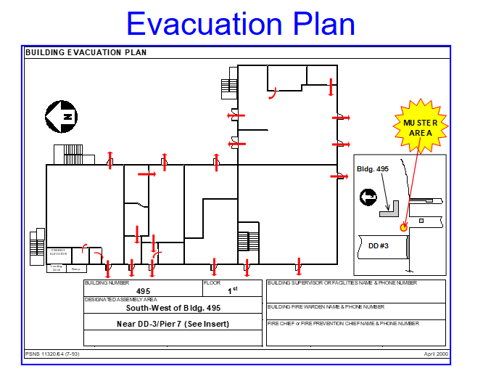
Emergency Management

Slide 22
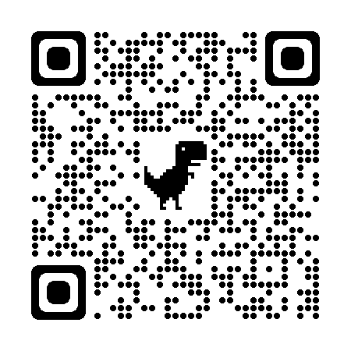
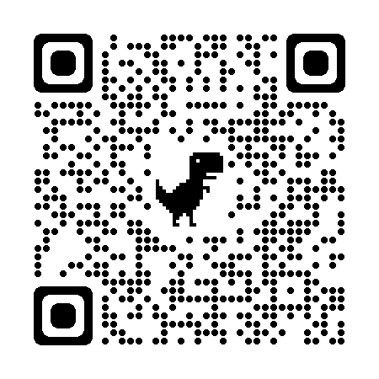
Contact Information
NPS SOH Office
Bldg. 330 / Ingersol Hall
Room 400
(831) 656-7661
safety@nps.edu
Safety Office Program POC’s
Safety Website

Slide 23


