Slide 1

Naval Postgraduate School
Fire Warden Training
References:
NFPA Standards and Regulations
Uniform Facility Criteria
COMNAVREGSWINST 11320

Slide 2

Topics of Discussion
Duties and Responsibilities of a Fire Warden
Types of Fire Extinguishers
Fire Extinguisher Inspections
How to Operate a Fire Extinguisher
Classes of Fire
General Housekeeping & Storage
Electrical Hazards
Space Heaters
Hazmat & SDS
Emergency Lights & Exit Signs
Fire Protection systems (FPS) & Mass Communication
Exit Routes, Emergency Action Plans, Fire Prevention Plans, and Fire Protection
Fire Drills
Fire and Emergency Evacuation Procedures
Fire Watch
Emergency Points of Contact
Open Flame and Outdoor Cooking

Slide 3
Duties and Responsibilities of a
Fire Warden
Attend Annual Fire Warden Training.
Report Life Safety Deficiencies to NAVFAC & Safety.
Submit Service Request for Deficiencies to NAVFAC.
Conduct Monthly Fire Inspections of Area of Responsibly (AOR).
Fire Extinguishers.
Emergency Exit Signs & Lighting.
General Fire Safety in Offices, Labs, Classrooms, Etc.

Slide 4
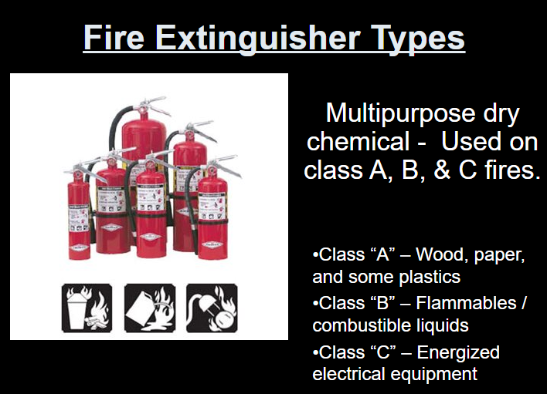
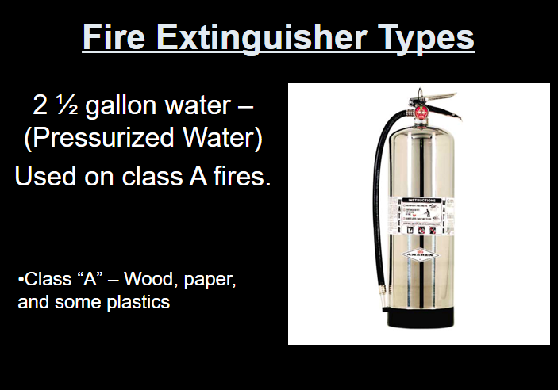
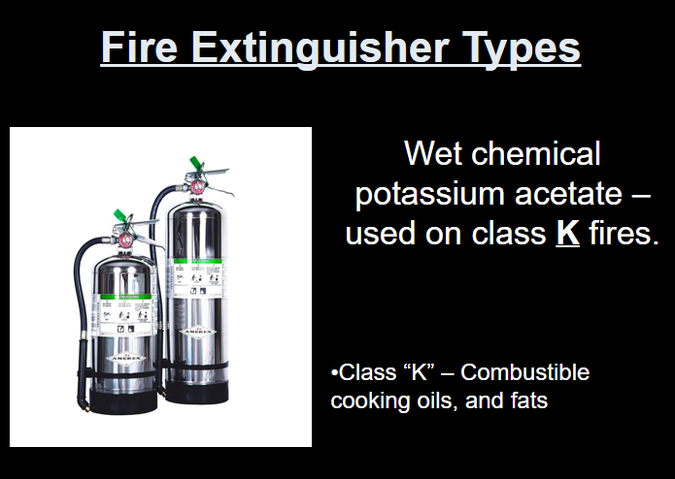
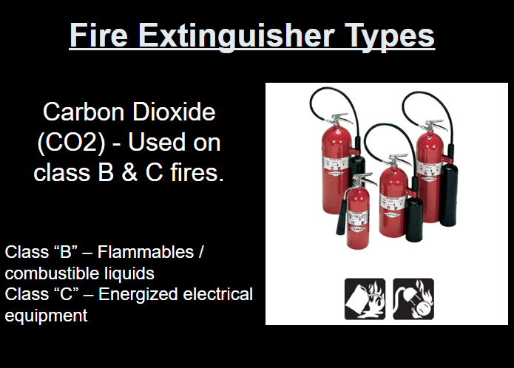
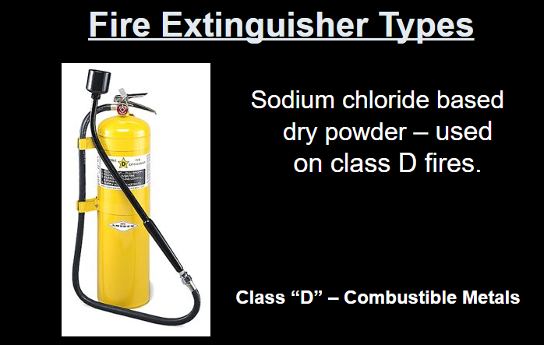
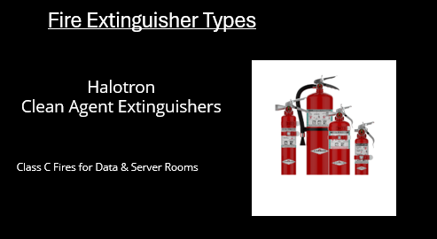
Types of Fire Extinguishers

Slide 5
Fire Extinguisher Inspections
Properly mounted with signage.
No obstructions within 36 inches.
Cylinder (free of damage).
Gauge (in the green).
Hose/nozzle (free of damage/obstruction).
Pin and seal (intact).
Sign the tag/decal.
Report deficiencies to NPS Safety.

Slide 6
How to Operate a Fire Extinguisher (PASS)

Slide 7
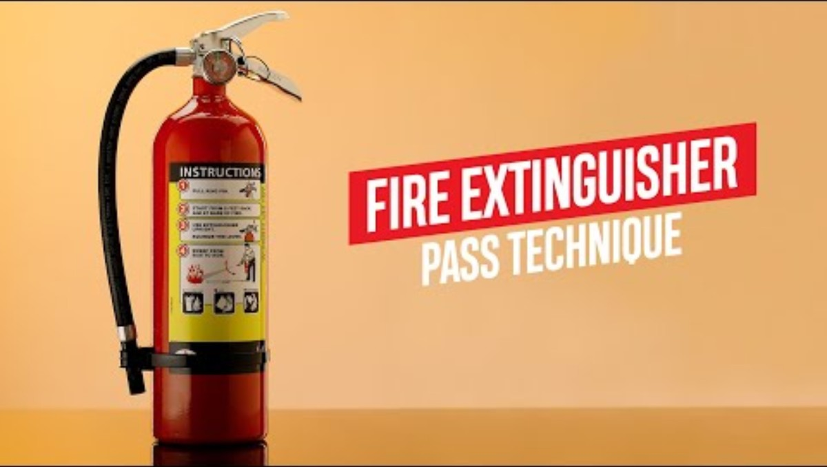
How to Use a Fire Extinguisher

Slide 8
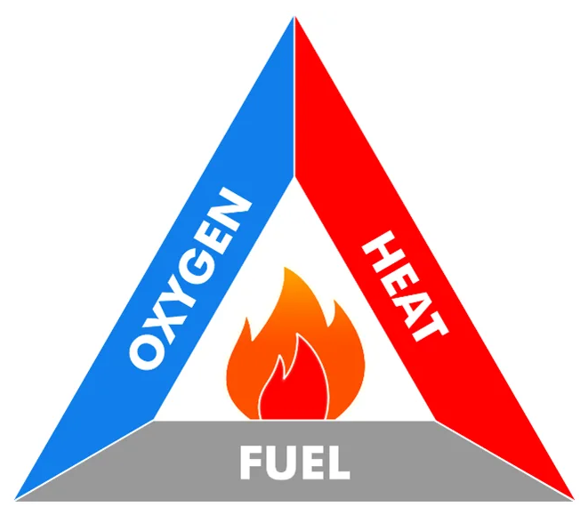
Fire Triangle
The fire triangle is a simple model that explains what elements need to be present for a fire to ignite and burn. It consists of three elements: heat, fuel, and oxygen. Without either of these three, a fire cannot start or sustain itself.

Slide 9
Classes of Fire

Slide 10

General Housekeeping & Storage
Office and work areas must be free from accumulation of combustible materials to reduce fire load.
Paths of egress must be free of obstruction within 36 inches.
If there is a double door the path must be the wide of both doors.
Recyclables/waste materials must be stored in approved containers.

Slide 11
Storage Requirments
No Storage in Mechanical Rooms.
No Storage Under Stairwells.
No Storage within 36 inches of Fire Protection System and Components.
No Storage within 18 inches of Fire Sprinkler Systems.
No Storage near Heaters, Air Ducts and Lighting Fixtures.
No Storage with in 36 Inches Electrical Panels.

Slide 12
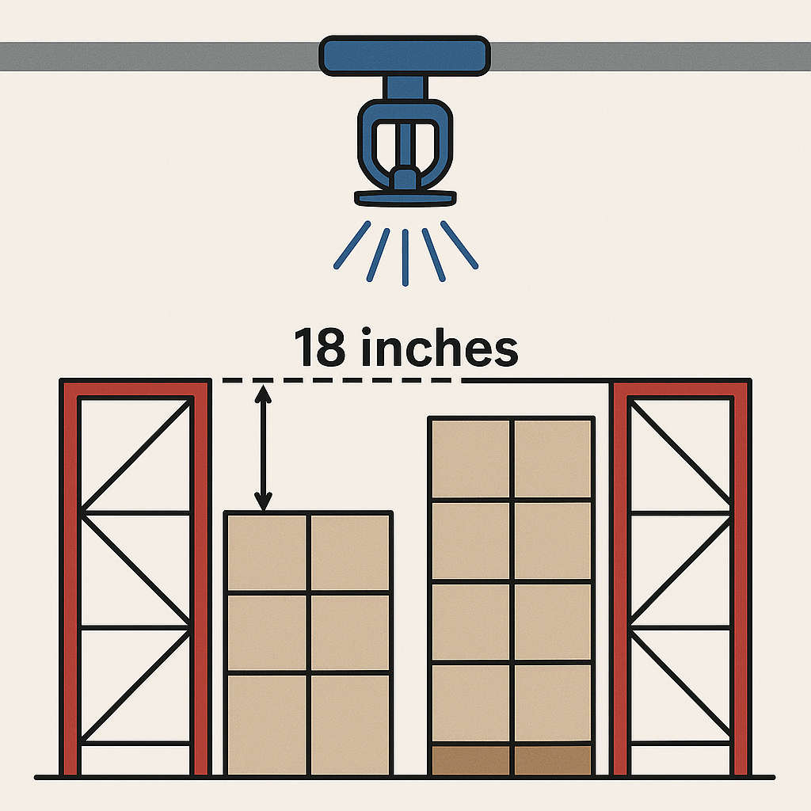
18-Inch Rule
Purpose: To prevent storage or any other obstruction from interfering with the sprinkler's spray pattern during a fire.
Requirement: Any storage or obstruction must be kept at least 18 inches below the sprinkler head deflectors.
Exceptions: In some cases, if storage is close to the ceiling, in-rack sprinklers or other special protection methods might be required.

Slide 13
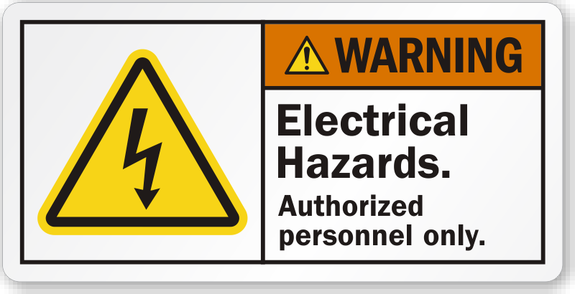
Electrical Hazards
Electrical panels must be free of obstruction within 36 inches.
Cabinets must be secure with fuses/breakers labeled.
No tampering or modifying fuses/breakers.
Outlets must be free of damage.
Cover plates must be intact with no exposed wiring.
GFCI surge protection within 6 feet of water sources.

Slide 14
Kitchen Appliances
• Cooking/heating appliances must be used on non-combustible surfaces (glass/tile).
Must be plugged directly into outlets (no power strips).
Attended while in use; disconnected/turned off while unattended.

Slide 15
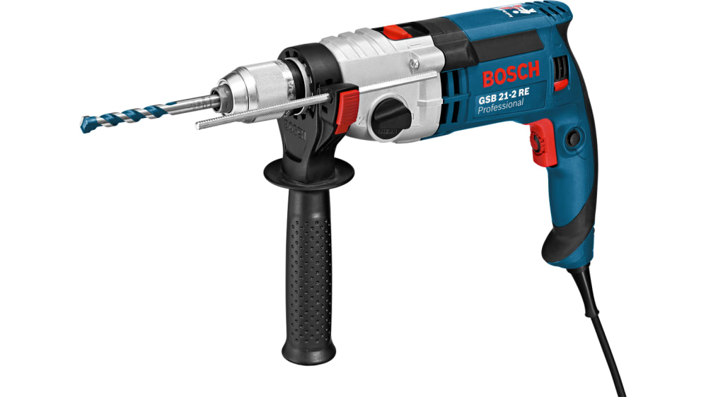
Power Tools
May be used with rated extension cords.
NOT for use with power strips.
Disconnected while unattended.

Slide 16
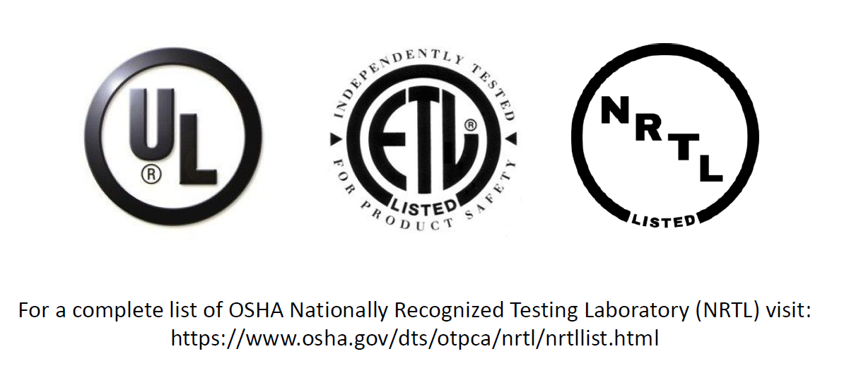
NRTL Listed Appliances

Slide 17
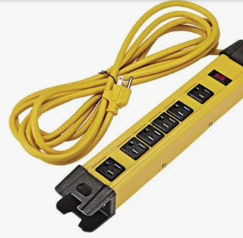
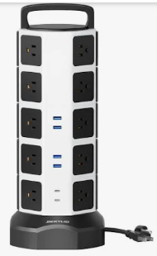
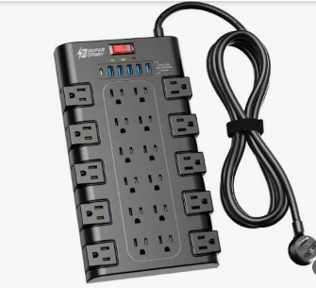
Power Strips
Must have overload protection (ON-OFF-RESET).
Must be self-grounding (3-prong).
Must be NRTL listed.
No daisy chains.
Must be plugged directly into outlets.
Not approved for use with extension cords.

Slide 18
Surge Protector
Primary Function: Also expands outlets, plus it protects connected devices from voltage spikes (e.g., caused by lightning or power outages).
Protection: Contains components (like MOVs — metal oxide varistors) that divert excess voltage away from devices.
Use Case: Essential for sensitive electronics like computers, TVs, gaming consoles, and networking equipment.

Slide 19
Extension Cords
Not approved as permanent wiring (NTE 90-days).
Must be self-grounding, undamaged and rated for use.
May not be used with power strips, splitters or adaptors.
Must be attended while in use, disconnected when not in use.

Slide 20
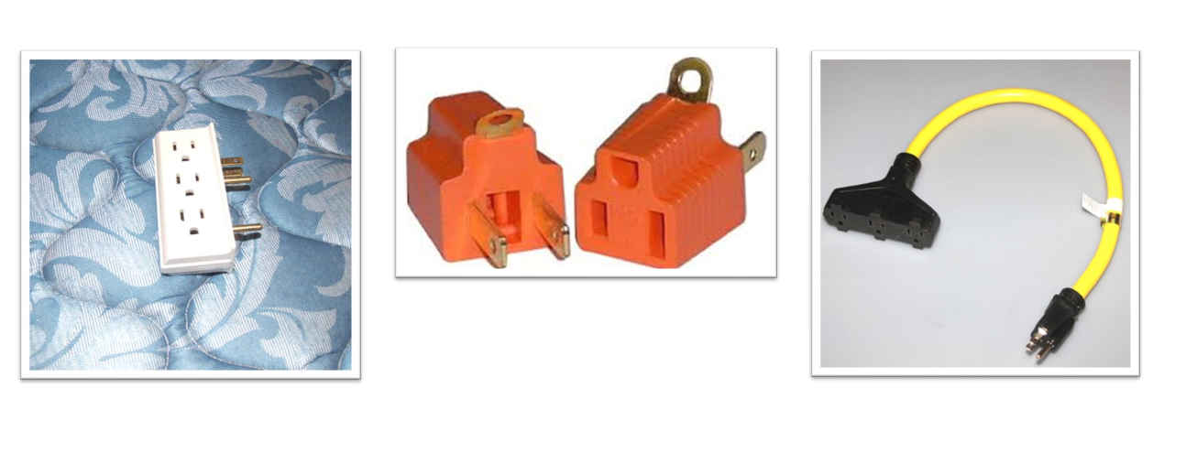
Unapproved Adaptors

Slide 21
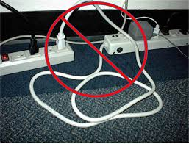
Improper Use
Daisy chaining power strips refers to the practice of plugging one power strip into another, and then potentially another, to extend the number of available outlets. This creates a "chain" of power strips connected in series, typically due to a lack of sufficient outlets. While seemingly convenient, daisy chaining power strips is generally considered unsafe and is often prohibited by electrical codes.

Slide 22
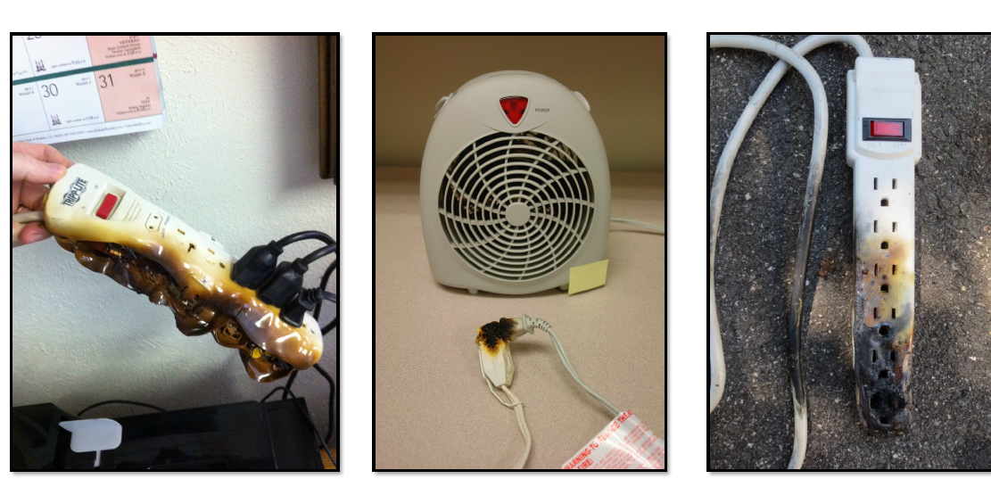
Electrical Fire Mishaps

Slide 23
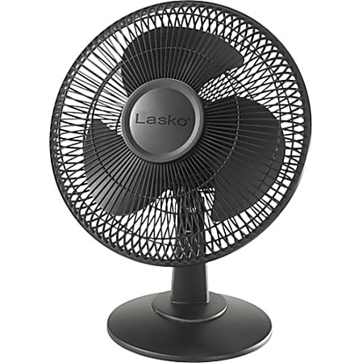
Fans/Humidifiers/Dehumidifiers
Approved for workplace use.
Must be plugged directly into outlets.
Attended while in use; disconnected/turned off while unattended.

Slide 24



Diffusers, Essential Oil Diffusers, Plug-Ins
Not Permitted for use on NSA Monterey

Slide 25
Holiday Decorations
Approved from OCT-DEC.
Artificial vegetation only.
Must be flame resistant.
May not obstruct doors, egress or Fire Protection Systems.

Slide 26
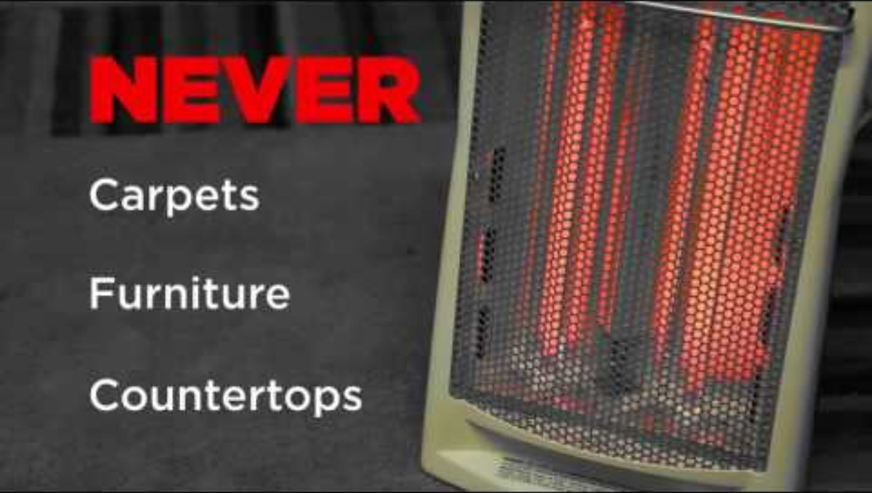
Space Heaters - PSA

Slide 27
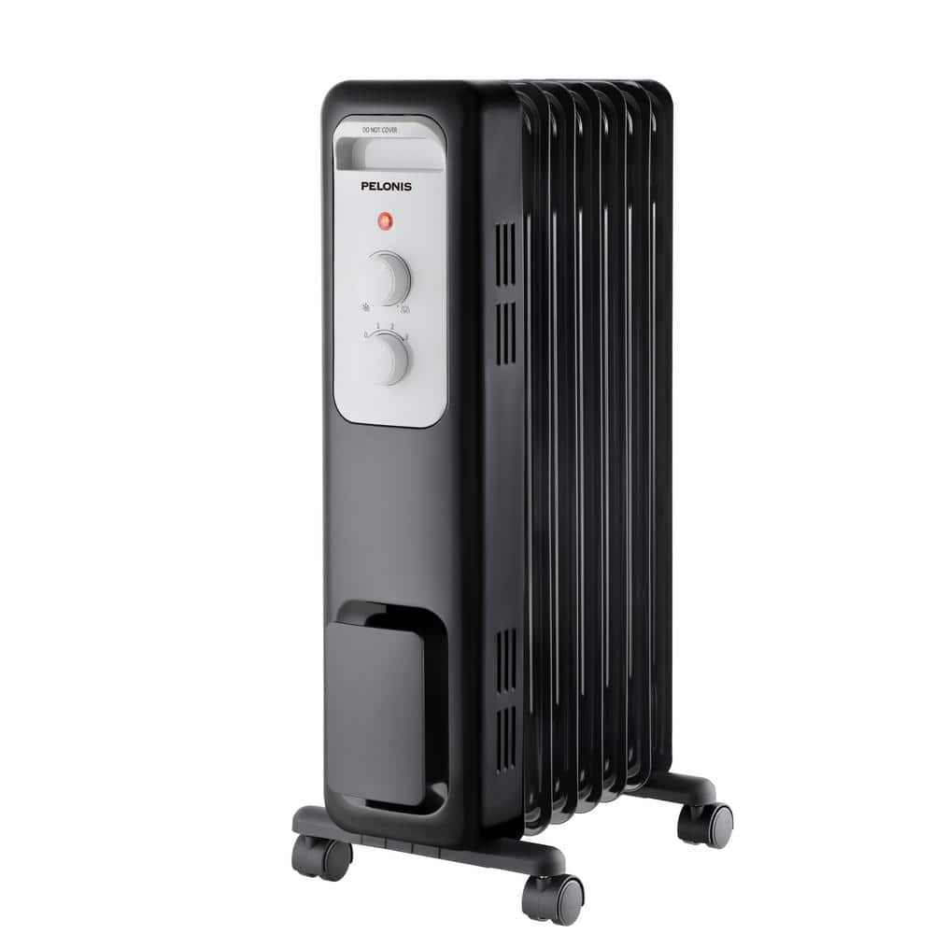
Space Heaters
NEW REQUIREMENT
Oil Filled Heaters
Approved by a Nationally Recognized Testing Laboratory (NRTL), UL or ETL.
Equipped with an automatic tip-over safety switch.
Include a thermostatic control to prevent overheating.
Capable of maintaining temperatures below 212°F.
Certified as Energy Star® or FEMP-recommended products.

Slide 28

Proper Use of Space Heaters
Placement and Monitoring:
Keep heaters at least three feet away from combustibles (e.g., paper, furniture, draperies).
Never use space heaters near water unless plugged into a GFCI outlet.
Electrical Safety:
Only one space heater per electrical circuit.
Avoid using heaters with damaged parts, cords, or missing ground prongs.
Operation:
Turn off heaters when leaving your workspace. Heaters should never be left on unattended.
Unplug heaters at the end of the workday.
Compliance Checks:
Spot checks will be conducted to ensure adherence to these policies.

Slide 29
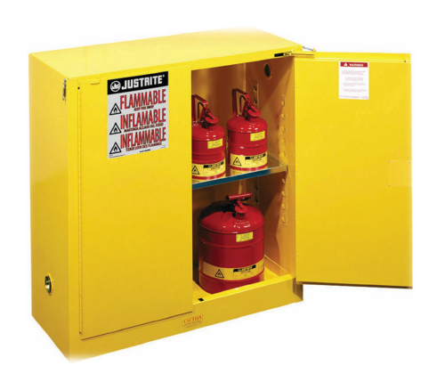
Hazmat
Must be approved for use.
Must be stored in approved Storage Lockers.
Storage Not to Exceed (NTE) 25 gallons.
Dispensing NTE 5 gallons.
Facility Storage Placarded IAW NFPA 704.
Safety Data Sheets (SDS) available on-site.
Cleaning gear doesn’t require a Hazmat Storage Locker, but SDS’s are Required.

Slide 30
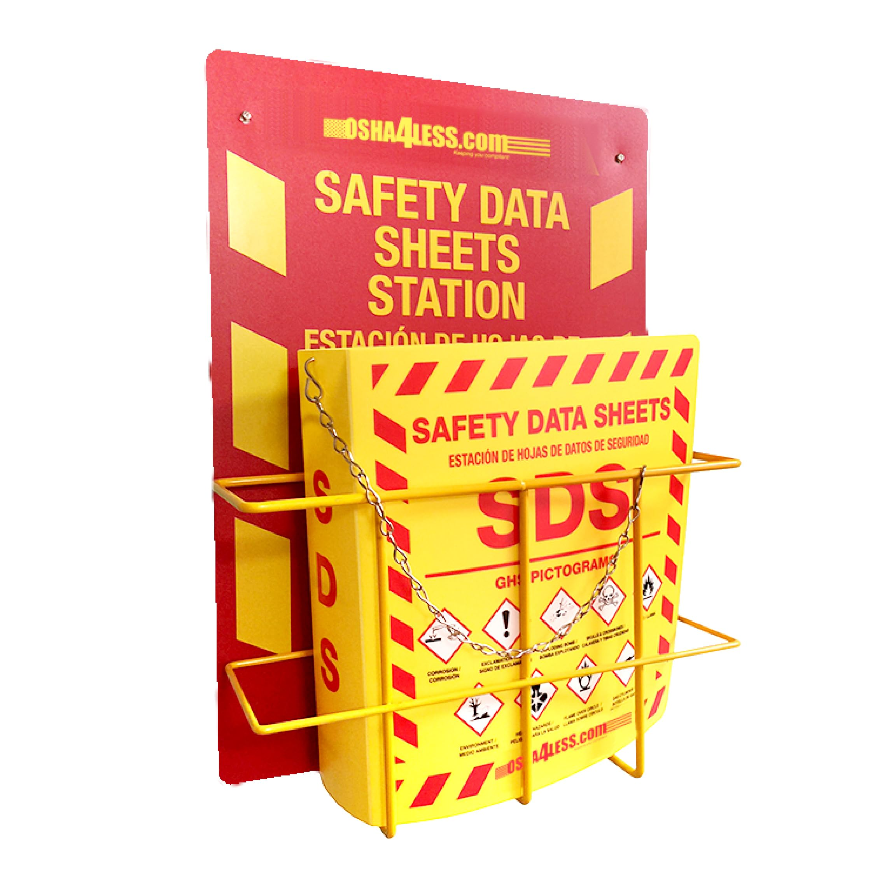
Safety Data Sheets
Required for all workplace hazardous materials!
Includes:
1. Chemical Information
2. Known Hazards
3. First Aid
4. Mitigation and Handling
5. Regulatory Requirements
6. Workplace Responsibilities

Slide 31


Open Flame
Open Flames Not Permitted in any Building onboard NSA Monterey

Slide 32

Outdoor Cooking
Outdoor cooking and deep fat frying is permitted in pre-designated areas or w/permit from NPS Safety Office.
Request must be made 3 days in advance.
Subject to weather (Fire Weather Watch/Red Flag Warnings).
Extinguisher accessible within 75 feet.
No use of accelerants/match-light coals.
Coals must be disposed of in coal disposal bins and fully extinguished before departure.

Slide 33
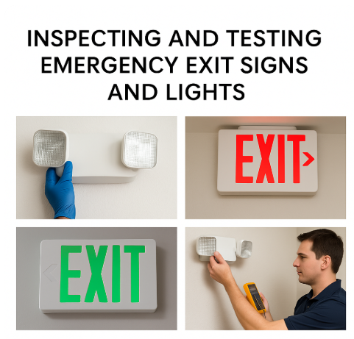

Slide 34
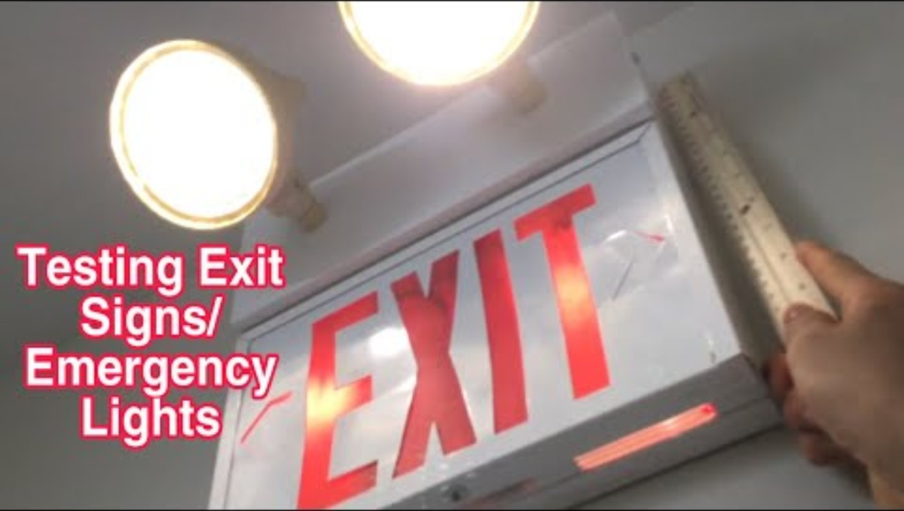
Emergency Lights & Exit Signs

Slide 35
30-Second Push Button Test
Use a Step Stool or Ladder (Maintain 3 Points of Contact).
Use a Non-Conductive Device, (Pencil, Ruler, Wooden Dowl Rod).
If Light Fades or Goes out, Battery is Dead.
If Battery is Dead Submit a Service Request.

Slide 36
Beeping Panels vs. Facility Alarms
Trouble alarms (beeping panels) generally do not activate the entire facility fire alarm system.
Trouble alarms could be a detector activation, system low battery, or other system deficiency.
For beeping panels, first investigate (panel should display the location of the problem).
If a fire is discovered, activate the alarm by pull station, evacuate, then call 9-1-1.
If no fire or emergency, submit work order.

Slide 37
Fire Alarm Panels & Mass Communication
Facility Mass Notification Systems interface with Fire Protection Systems but are a separate.
Use Only in the Event of an Actual Emergency.

Slide 38
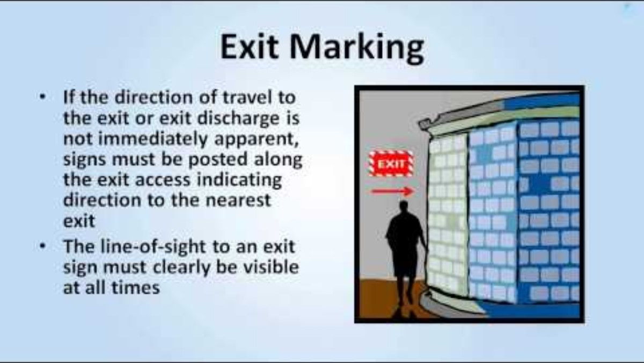
Exit Routes, Emergency Action Plans, Fire Prevention Plans, and Fire Protection

Slide 39
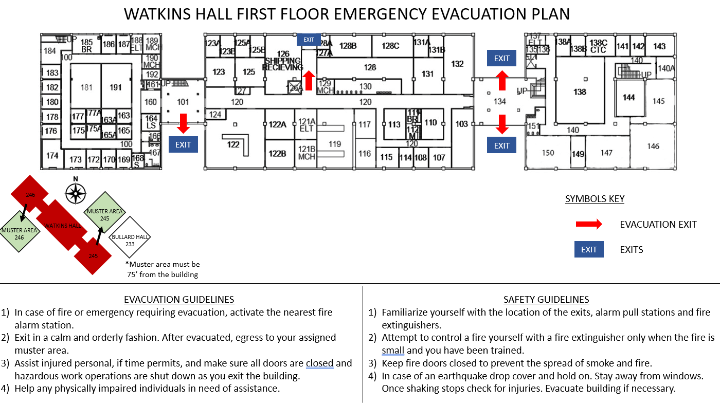
Emergency Egress Maps

Slide 40
Fire & Emergency Evacuation Procedures
Activate the fire alarm.
Call 911 immediately and provide information.
Secure power to Space Heaters and other devices.
Close ALL DOORS behind you as you leave your office, lab, space.
Assist injured personnel or notify emergency responders of the medical emergency.
Stay low if confronted with smoke.
Use a fire extinguisher only if it is safe to do so and you have been trained.
Do not use the elevators.
Exit the building within 5 minutes or less following emergency maps.
Relocate yourself to 75 Feet from the building. (35-40 Paces).
Assemble your department personnel at a remote location determined by your Chair or Director.
Make sure there is personnel accountability within 10 minutes of leaving the building.
Report any hazardous conditions to the Incident Commander.
Stay Out and Away from the building until it is safe to return. (Police, Fire Department, Safety will give all clear, once the Emergency or Drill is complete).

Slide 41

Fire Watch
When the Fire Protection System is Impacted, Reduced, or Out of Service.
Business Hours – All Hands
After Hours - NSAM Base Police
Signage will be posted.
Procedures will be Passed Along to Building Occupants on What Steps to Take.

Slide 42
Emergency Points of Contact
For all emergencies contact Base Police at (831) 656-2555 (CNRSW Regional Dispatch Center) or dial 911 (Monterey County 911 System).
For Emergency Work Requests Needing Immediate Response: Call (831) 656-2526 (manned 24/7/365).
24/7 NPS Command Duty Officer (CDO@nps.edu) 831-901-6649

Slide 43
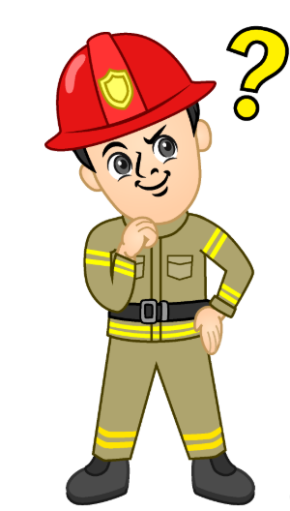

Questions?

